Slide 1
Data Structures

Slide 2
Agenda
Deletion in Heaps
Heap Sort
Kth largest element in an array

Slide 3
Heaps
A Heap is a special Tree-based data structure in which the tree is a complete binary tree. Generally, Heaps can be of two types:
Max-Heap: In a Max-Heap the key present at the root node must be greatest among the keys present at all of it’s children(descendants). The same property must be recursively true for all sub-trees in that Binary Tree.
Min-Heap: In a Min-Heap the key present at the root node must be minimum among the keys present at all of it’s children(descendants). The same property must be recursively true for all sub-trees in that Binary Tree.

Slide 4
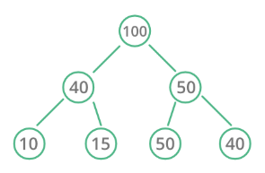
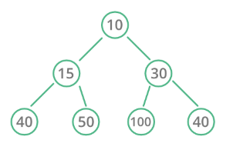
Types of Heaps
Max Heap
Min Heap

Slide 5
Insertion in Heaps
Given a Binary Heap and a new element to be added to this Heap. The task is to insert the new element to the Heap maintaining the properties of Heap.
Process of Insertion:
Insert the new element at the end of the Heap.
This newly inserted element may distort the properties of Heap for its parents. So, in order to keep the properties of Heap, heapify this newly inserted element following a bottom-up approach.

Slide 6
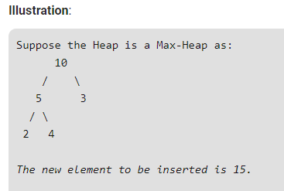
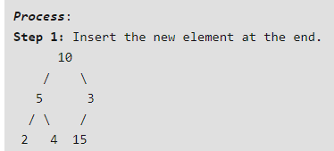
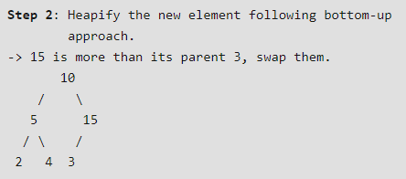
Insertion in Heaps

Slide 7
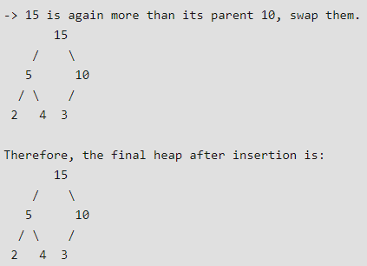
Insertion in Heaps

Slide 8
Insertion in Heaps

Slide 9
Deletion in Heaps
Since deleting an element at any intermediary position in the heap can be costly, so we can simply replace the element to be deleted by the last element and delete the last element of the Heap.
Replace the root or element to be deleted by the last element.
Delete the last element from the Heap.
Since, the last element is now placed at the position of the root node. So, it may not follow the heap property. Therefore, heapify the last node placed at the position of root.

Slide 10
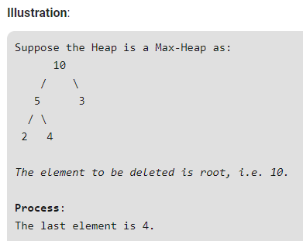
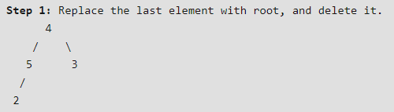
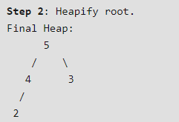
Deletion in Heaps

Slide 11
Deletion in Heaps

Slide 12
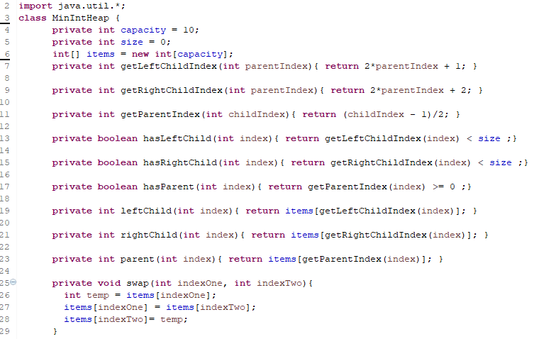
Array Implementation

Slide 13
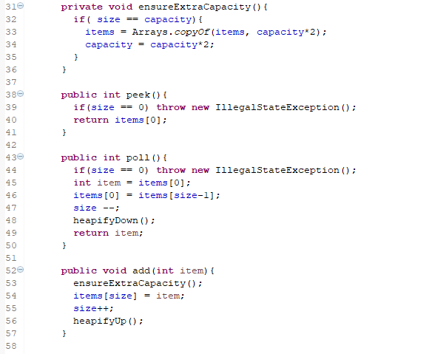
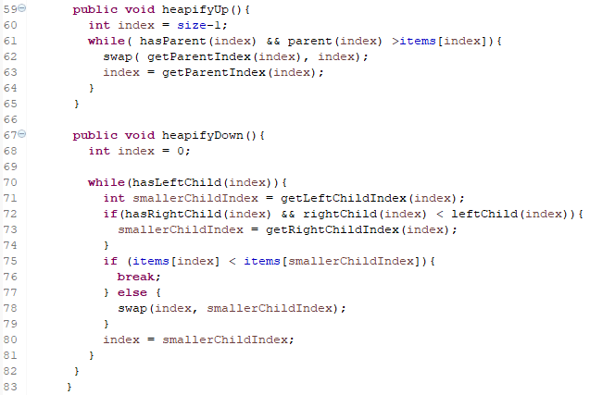
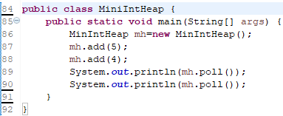
Array Implementation

Slide 14
Build Heap from an Array

Slide 15
Build Heap from an Array
https://www.geeksforgeeks.org/time-complexity-of-building-a-heap/

Slide 16
Heap Sort

Slide 17
Heap Sort

Slide 18
Heap Sort

Slide 19
Kth largest element in an array
Link: https://practice.geeksforgeeks.org/problems/kth-largest-element-in-a-stream2220/1

Slide 20
Kth largest element in an array
Link: https://practice.geeksforgeeks.org/problems/k-largest-elements3736/1

Slide 21
THANK YOU

